Slide 1

PORTFOLIO
Web Development
Dana Volovelsky

Slide 2
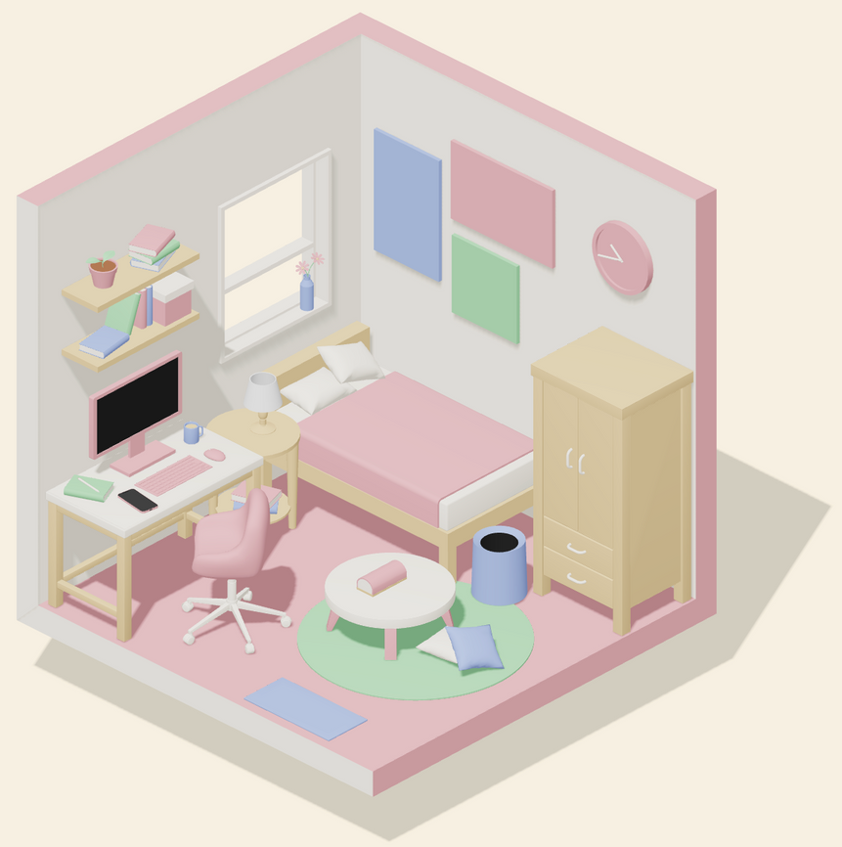
CONCEPT
Design the Website as an interactive 3D room

Slide 3
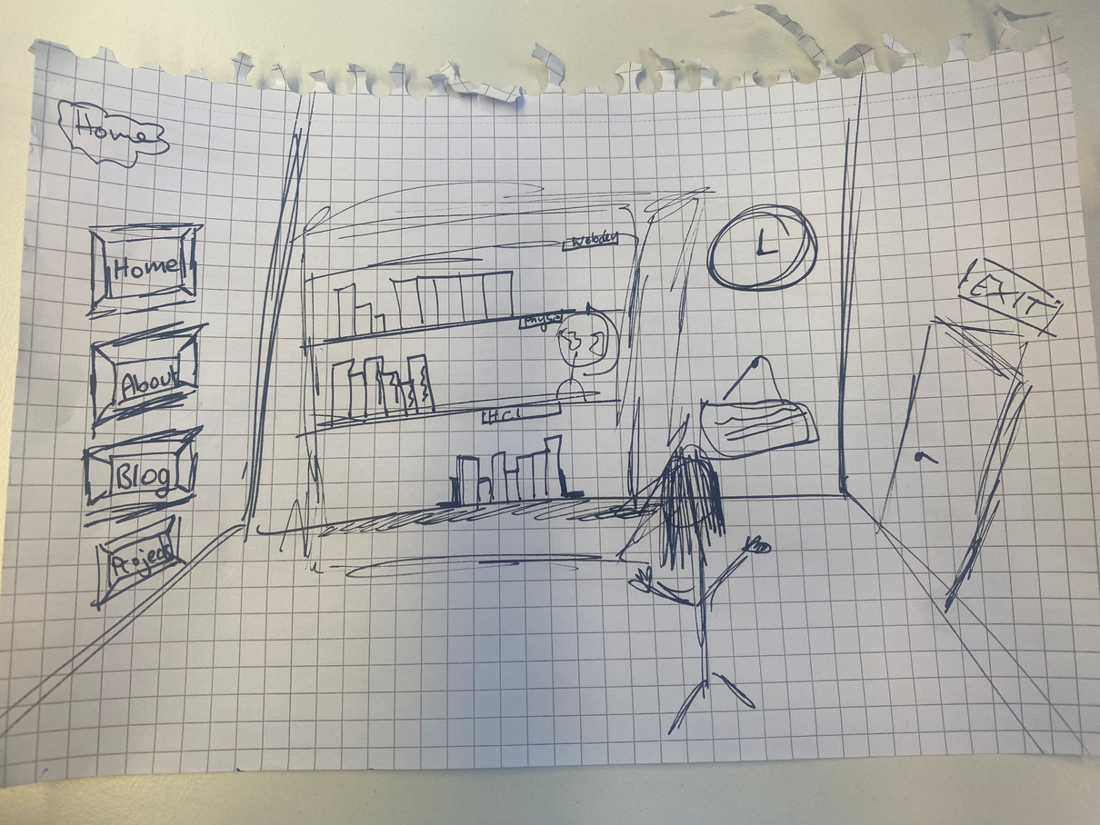
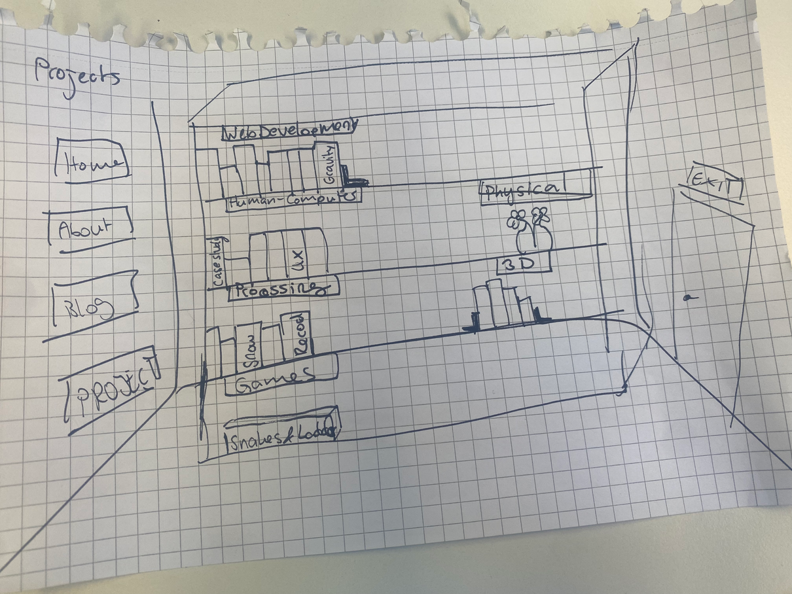
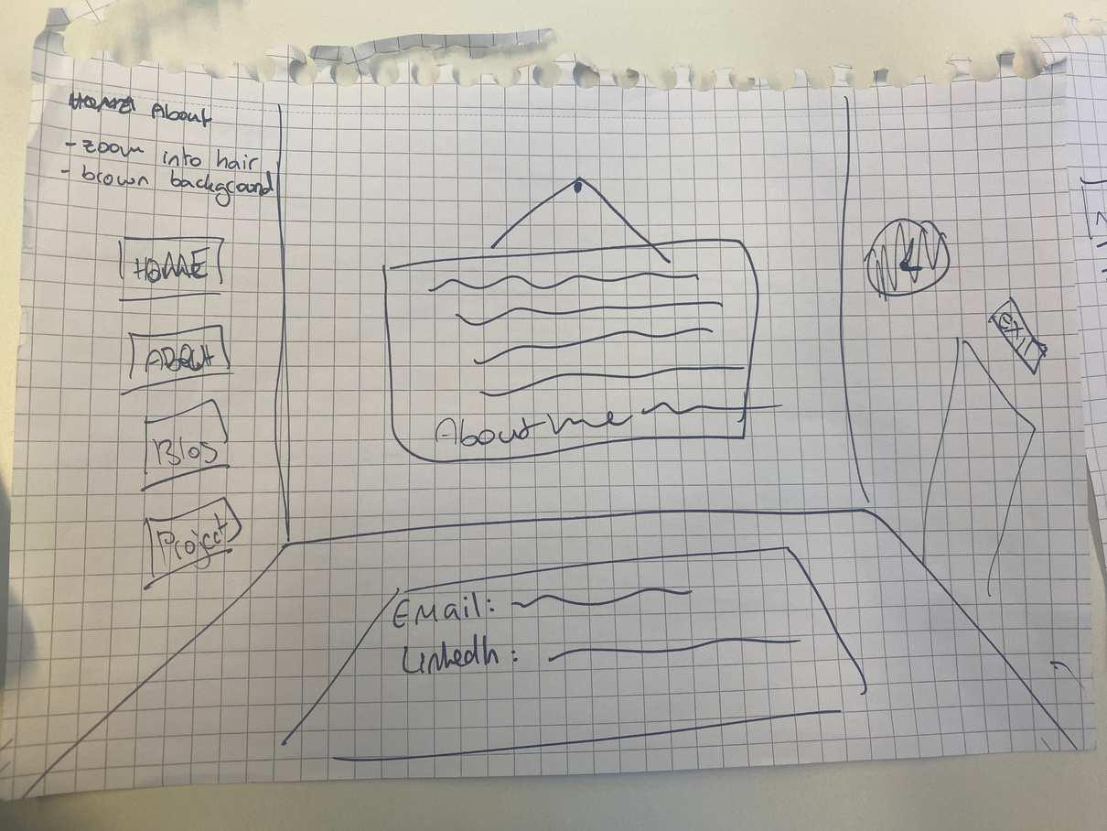
DIFFERENT PAGES
HOME
WORK
ABOUT

Slide 4
o1
DESIGN 3D ROOM
Build room (walls, floor) and objects; Make them clickable
o2
HOME SECTION
Navbar as picture frames; Interactivity (books, door, clock, ...)
PLANNING
o3
WORK SECTION
Hide objects; Enlarge bookshelf; Animate project books
o4
ABOUT ME SECTION
Hide objects; Enlarge paper/laptop; Add text and contact details

Slide 5
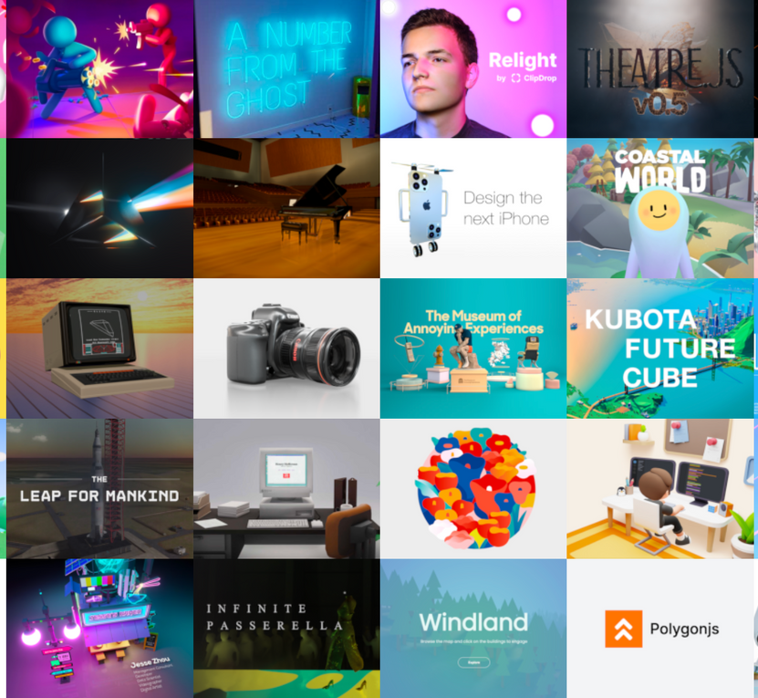
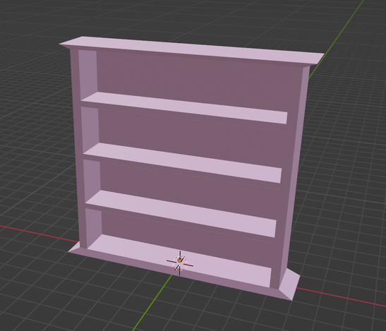
HOW?
Model objects with Blender
Interactivity with three.js

Slide 6
DIFFICULTIES
What part of the project should be done with three.js and which parts with Blender
Get textures and animations right (especially the books)
Time management

